Slide 1
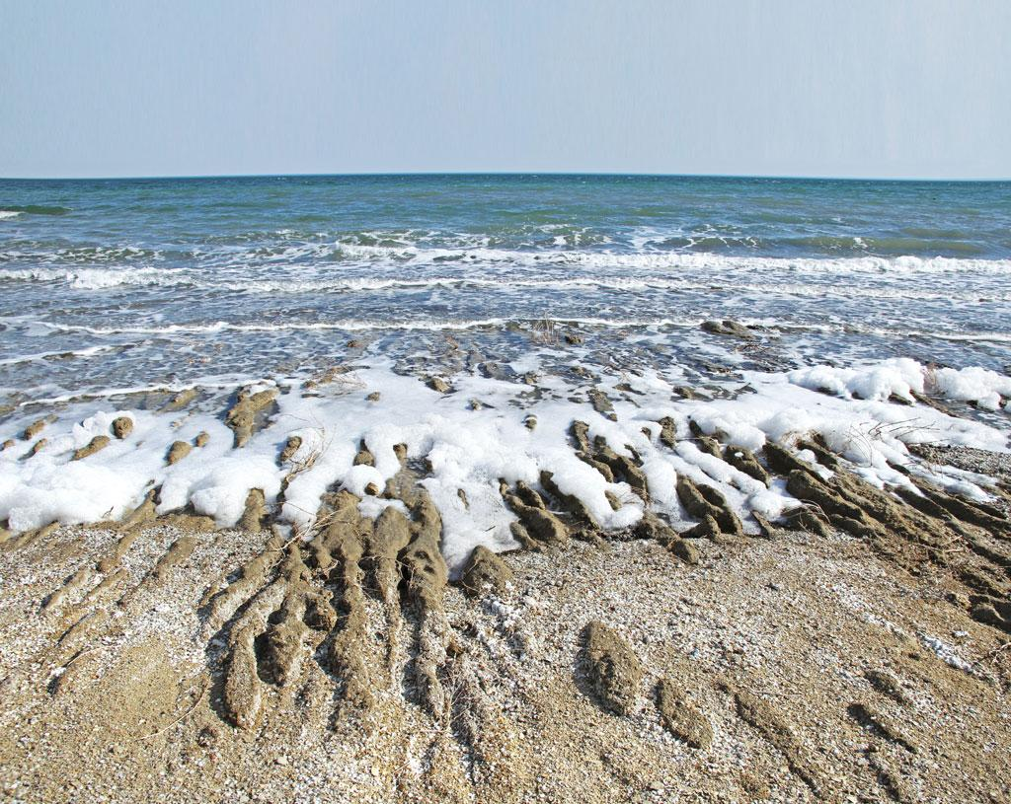
Raster GIS Analysis for Monitoring Change in Coastline- North Aral Sea, Kazakhstan
Tariq Haniff, Columbia College, GEOG-70 , F 2021

Slide 2
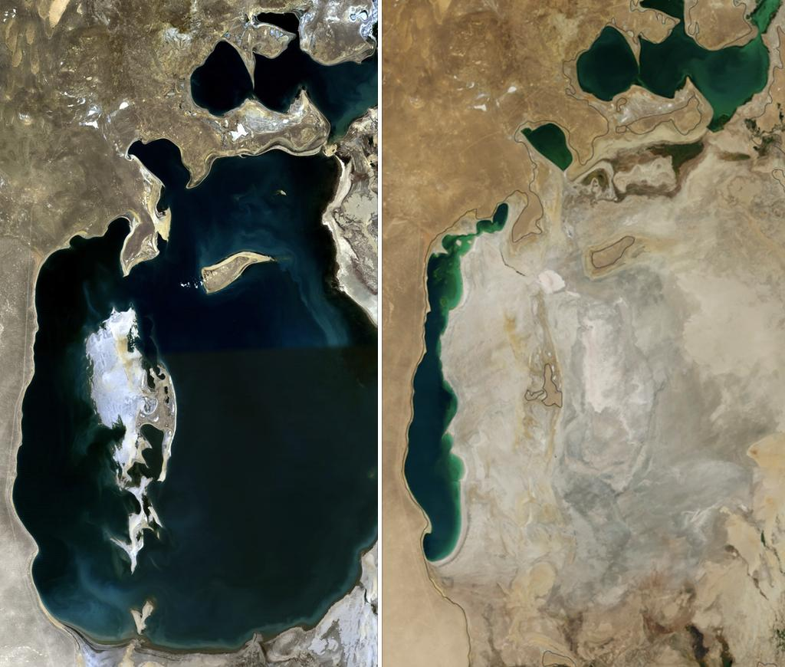
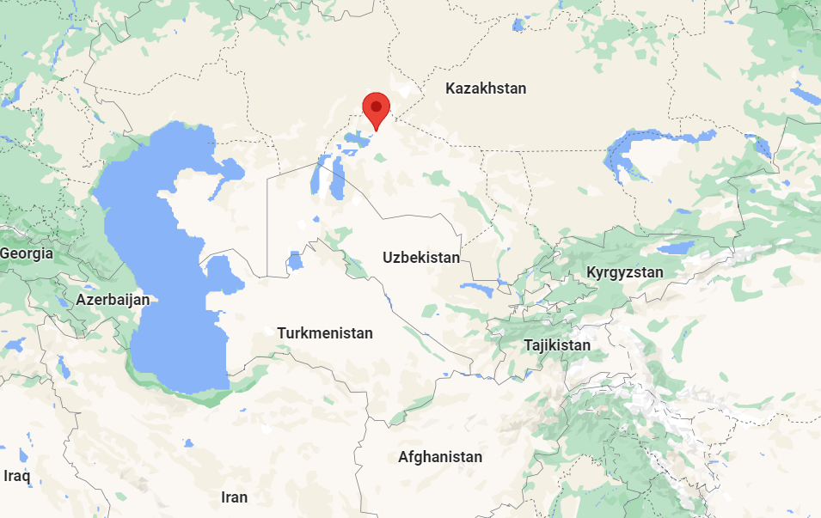
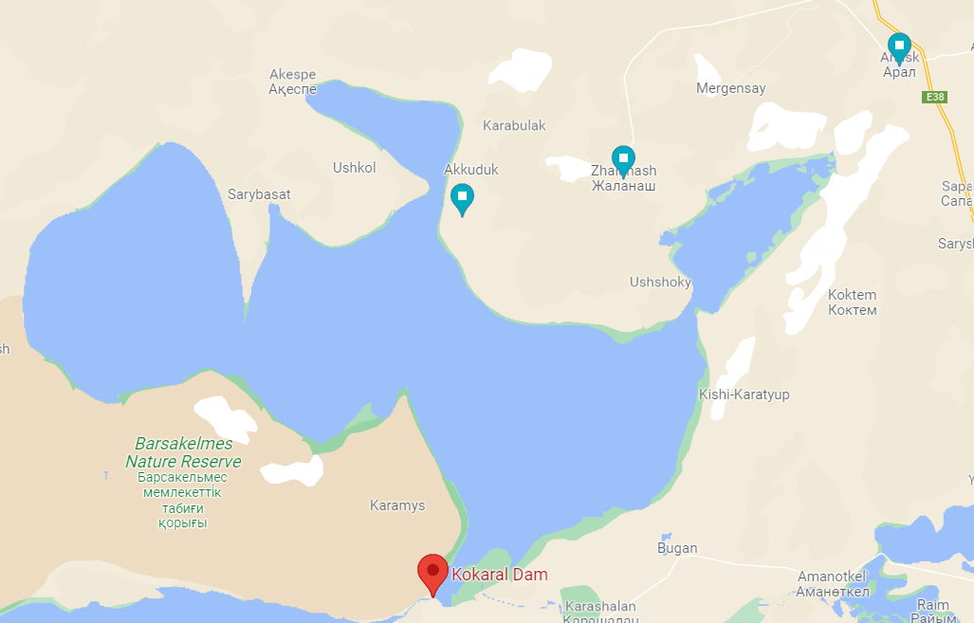
Objectives
To evaluate the effectiveness of Kokaral Dam on the increase in water level (and thus change in coastline) in the North Aral Sea, Kazakhstan
To demonstrate the usefulness of raster analysis and tools to evaluate this coastline change and similar scenarios.
1989
2014

Slide 3
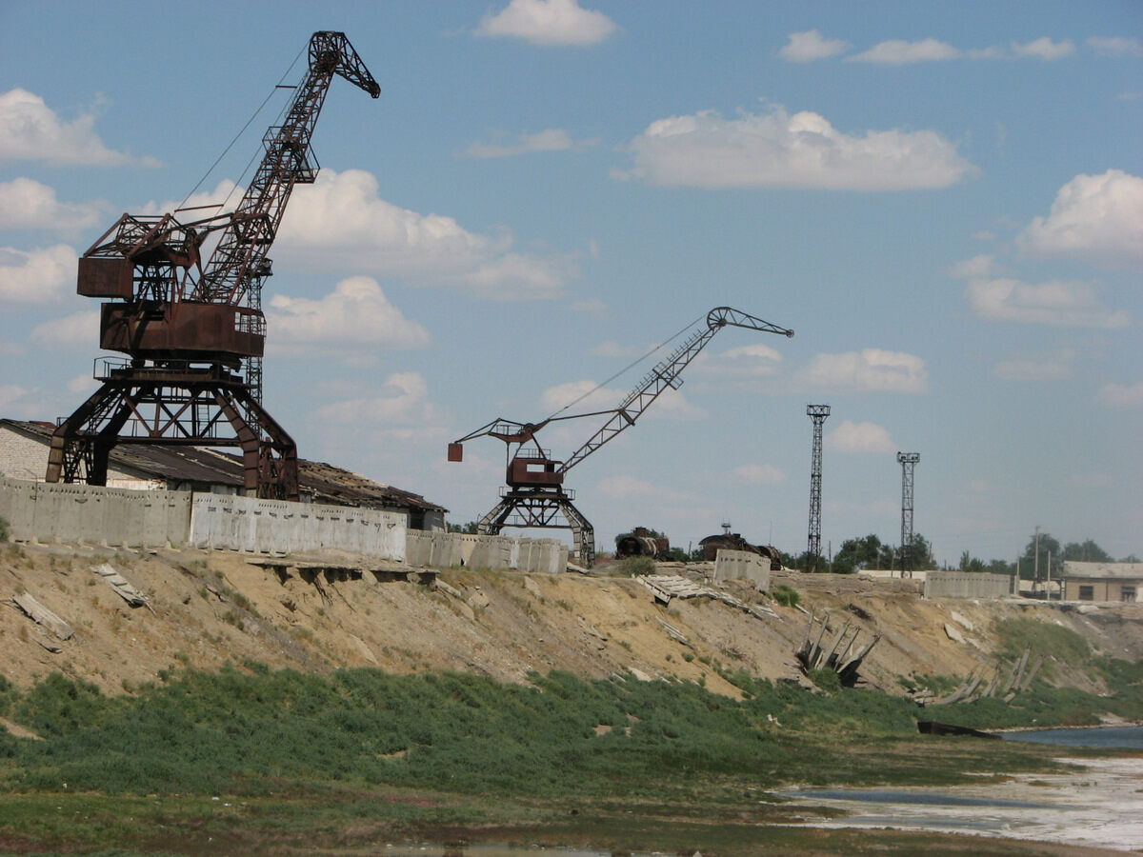
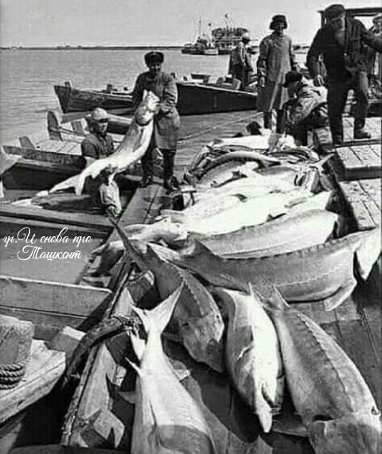
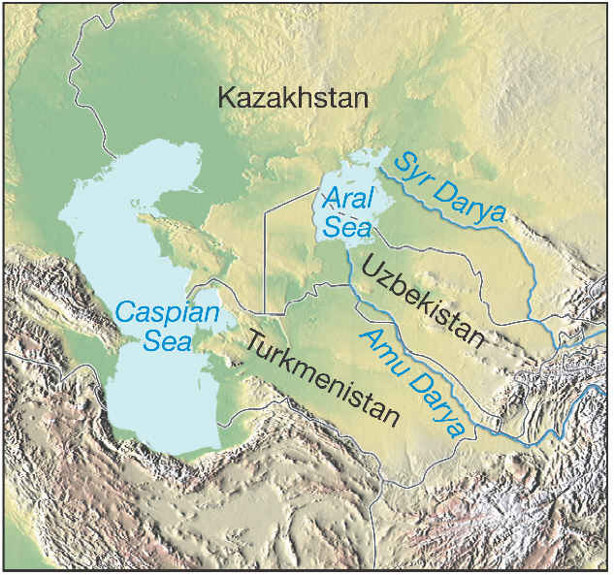
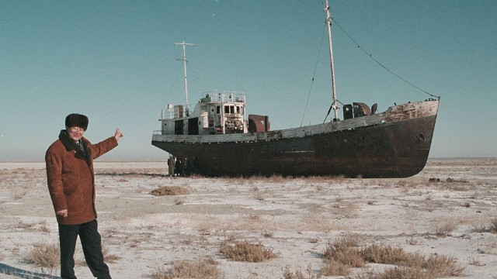
Background
Soviet Diversion of feeding Rivers for Wheat and Cotton Irrigation-late 1950’s

Slide 4
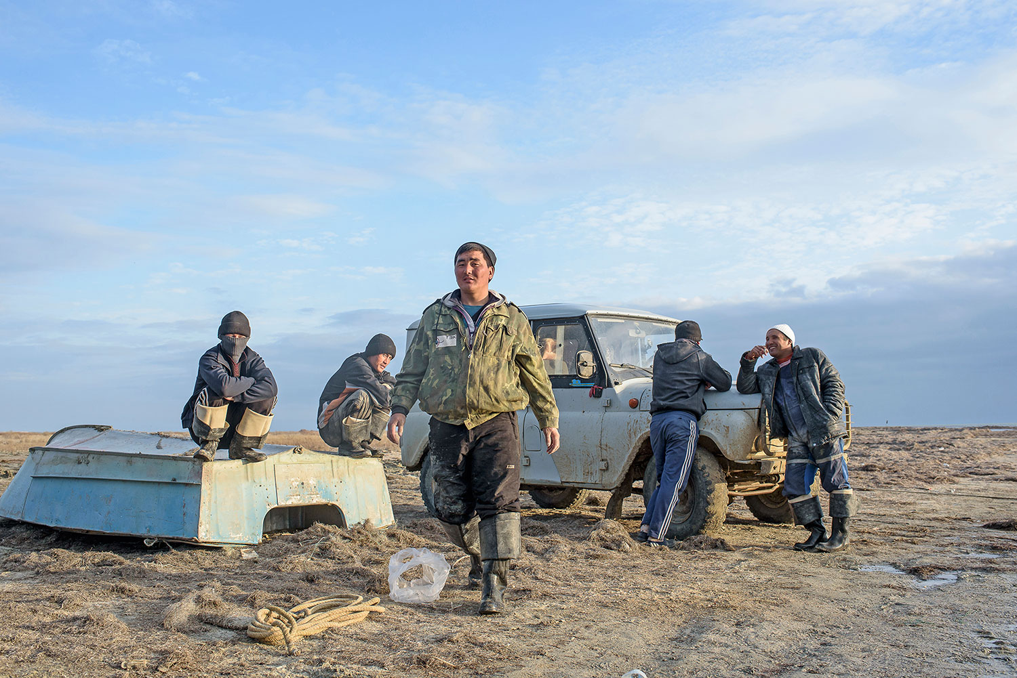
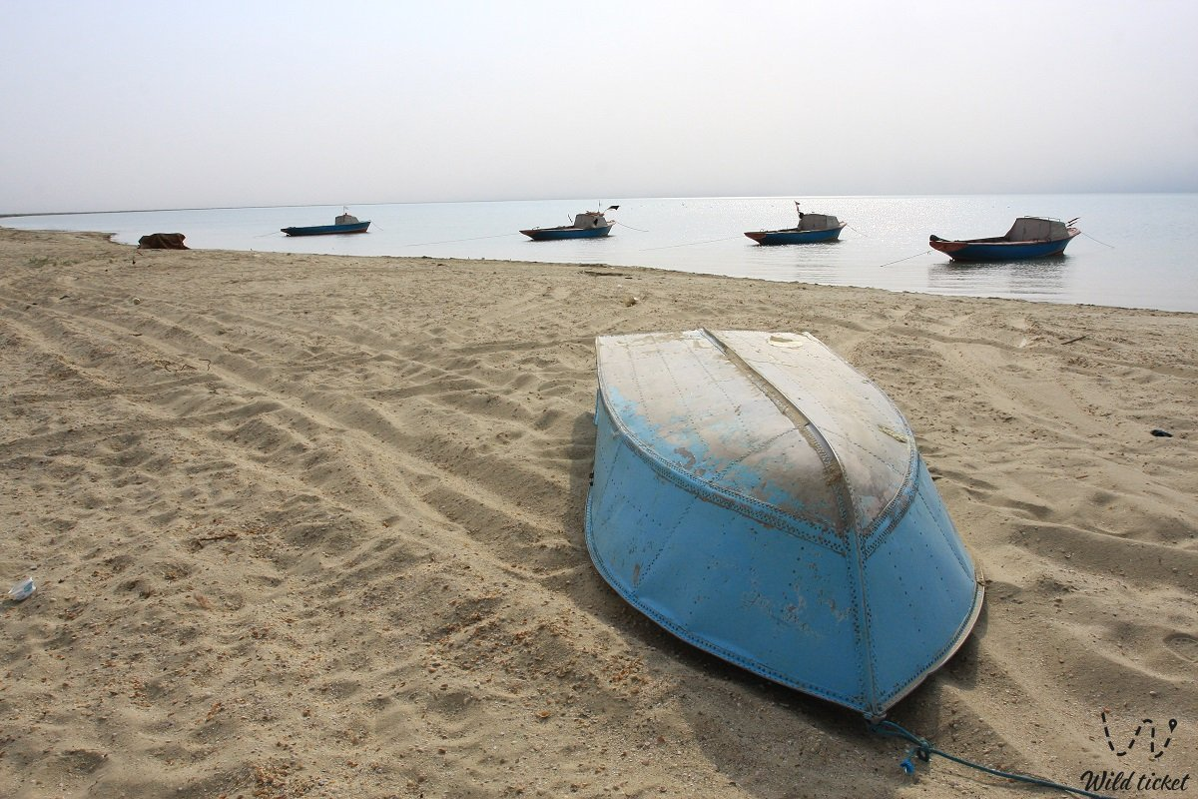
Background (cont’d)
Kokaral Dam 1992: Locals built low-tech Dam in Kokaral earthen materials
Highly effective but eventually collapsed in 1999
World Bank involvement
New modern Kokaral Dam finished in 2005
Calculated increase in water level achieved in 7 months rather than 10 years
Problem Statement
“Required travel distance from existing villages to coastline hinder redevelopment of fishing industry and community growth.”

Slide 5
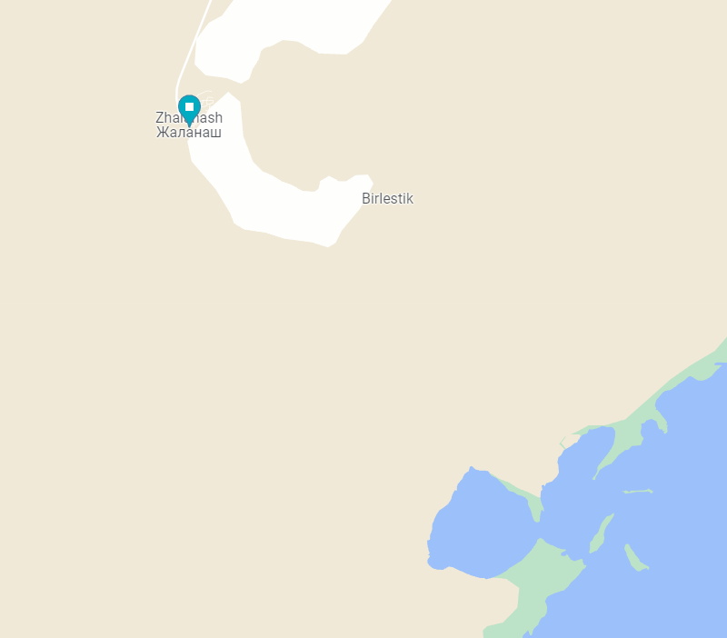
Methodology
Focus on Zhalanash village
Gather Satellite (“Landsat”) Imagery
USGS- “Glovis” or “Earth Explorer”
2005 (inception of Kokaral Dam)
2021 (present day)
Compare Raster Imagery in ArcPro
Evaluate Change in Coastline
Import Satellite Imagery
Reduce Imagery to binary data
Land and “Not Land-Barren Earth
Pixel detection “training”, Geo-tools
Supervised Training
Classify Imagery into year specific layers
Compare

Slide 6
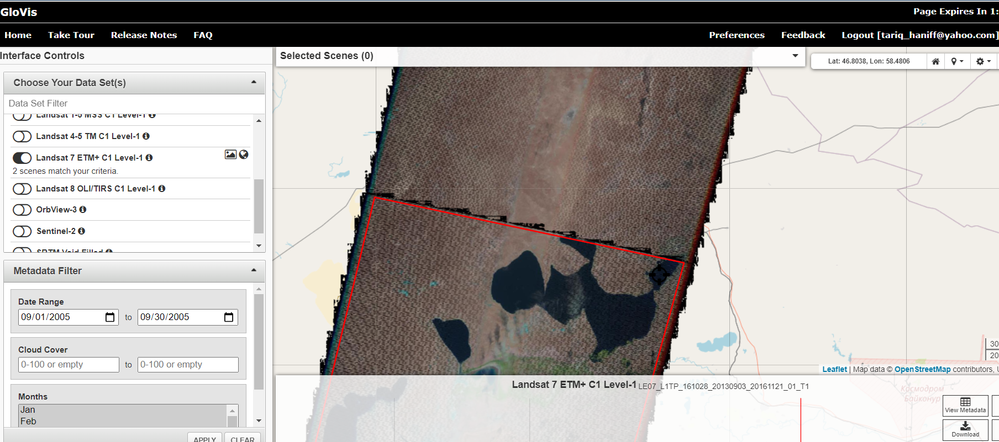
Methodology-Data
USGS : Glovis and “Earth Explorer Web Interface
Dam Inception: 2005- Landsat 7 available
Glovis Web Interface

Slide 7
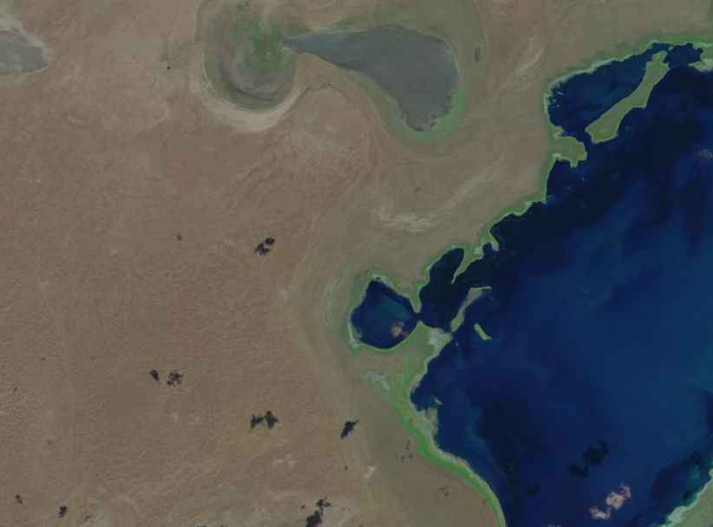
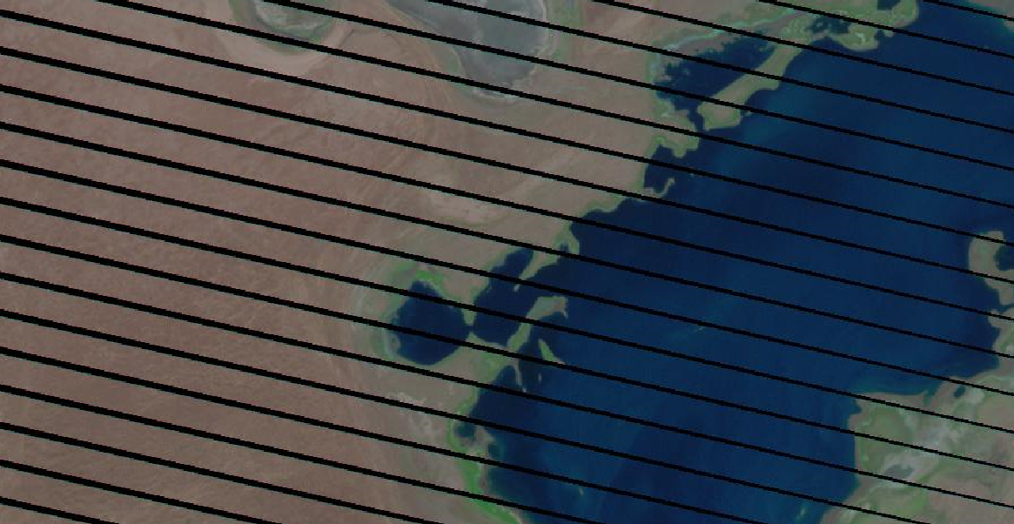
Methodology-Data
USGS : Glovis and “Earth Explorer Web Interface
Dam Inception: 2005-LandSat 7 available
2003 malfunction in Landsat 7
Black Bands- 25% loss
2013- First year of Landsat 8
Landsat 7 -2005
Landsat 8 -2013

Slide 8
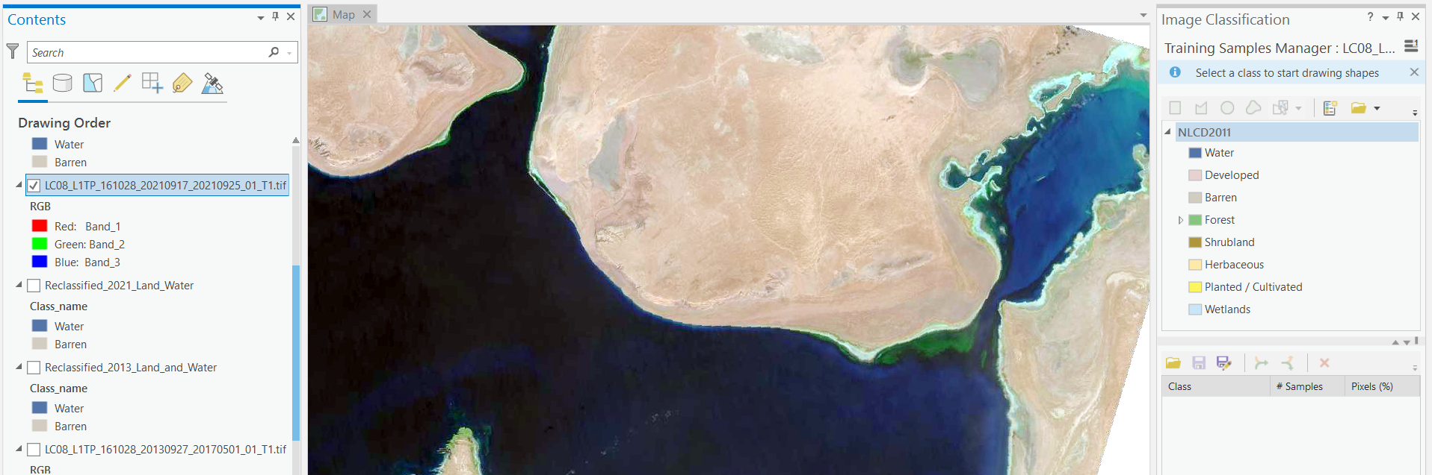
Methodology-Training Samples Manager
Designate/train ambiguous and uniform areas of Water and “Barren” land

Slide 9
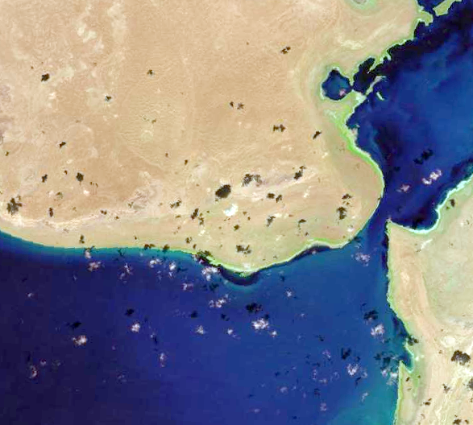
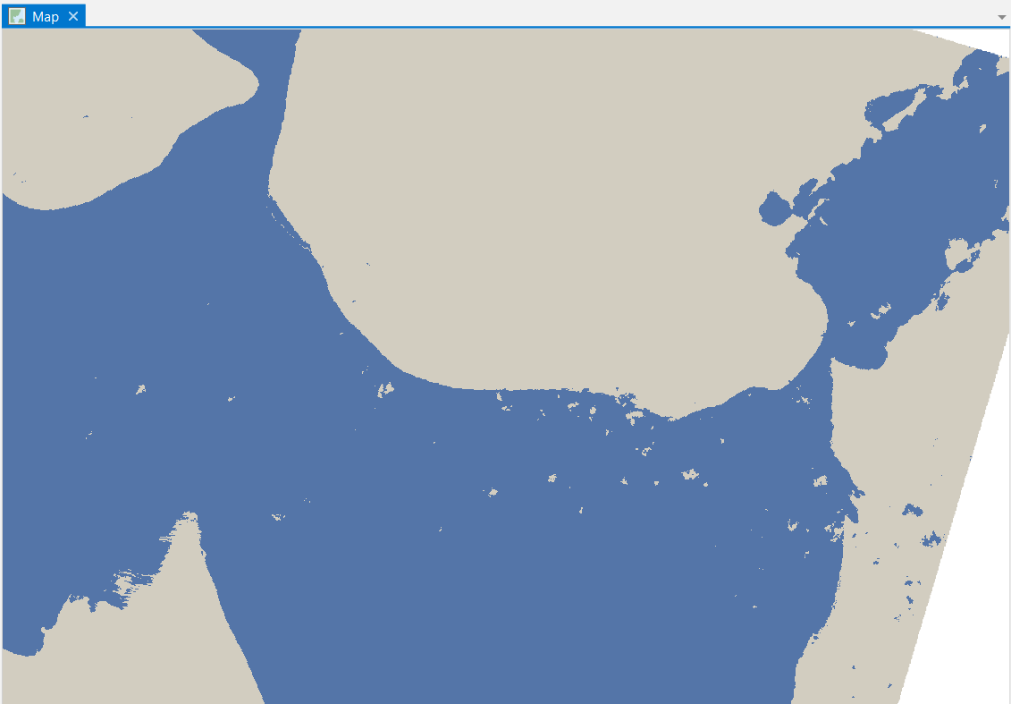
Methodology-Pixel Classification

Slide 10
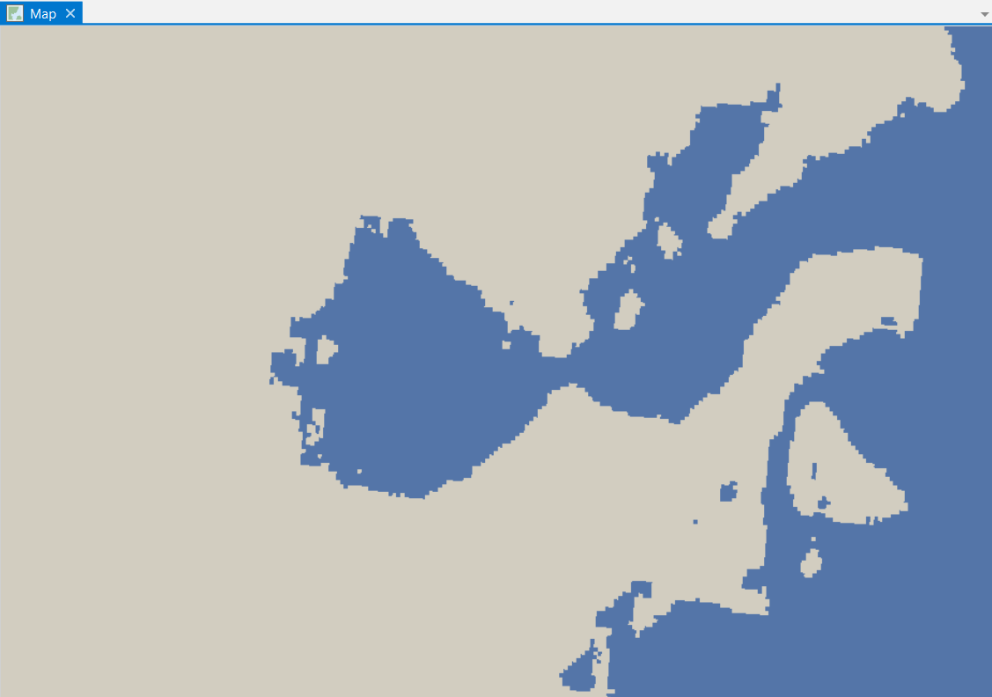

“Touch Up”- Reclassification
Initial Classification
Relassification

Slide 11
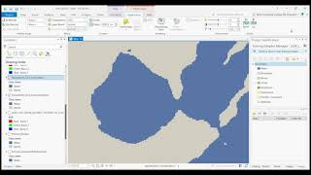
Flash Function
Compare 2013 vs 2021

Slide 12
Flash Function
Compare Classification to Imagery

Slide 13
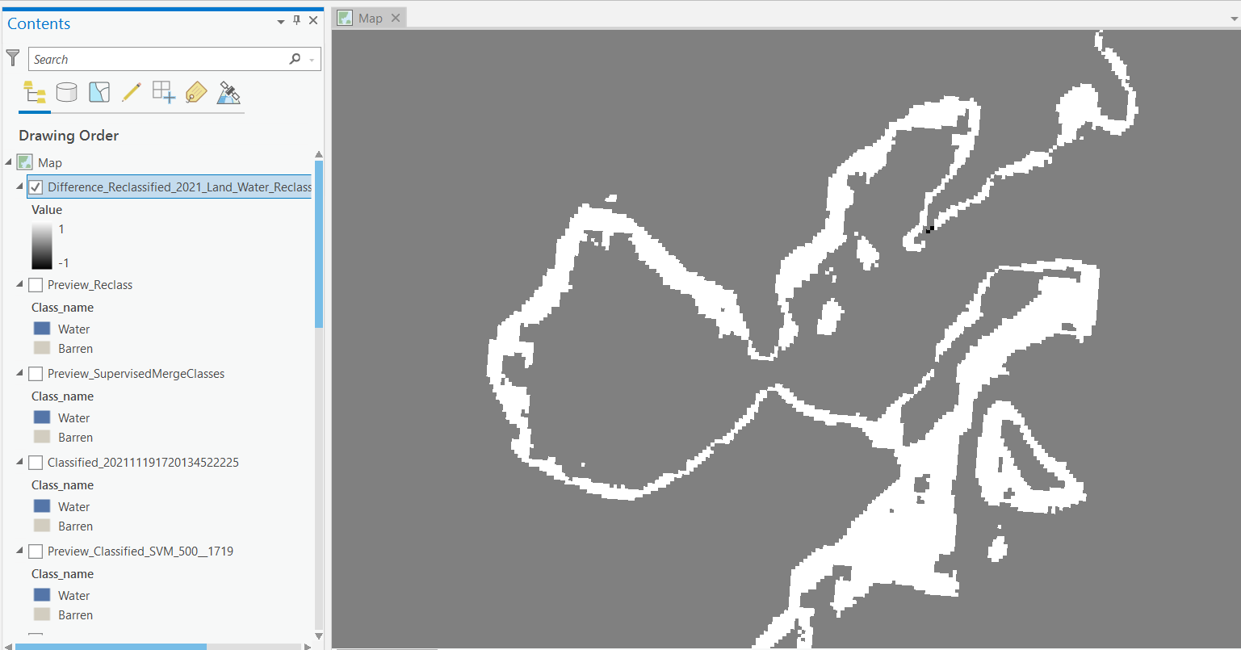
Difference Layer

Slide 14
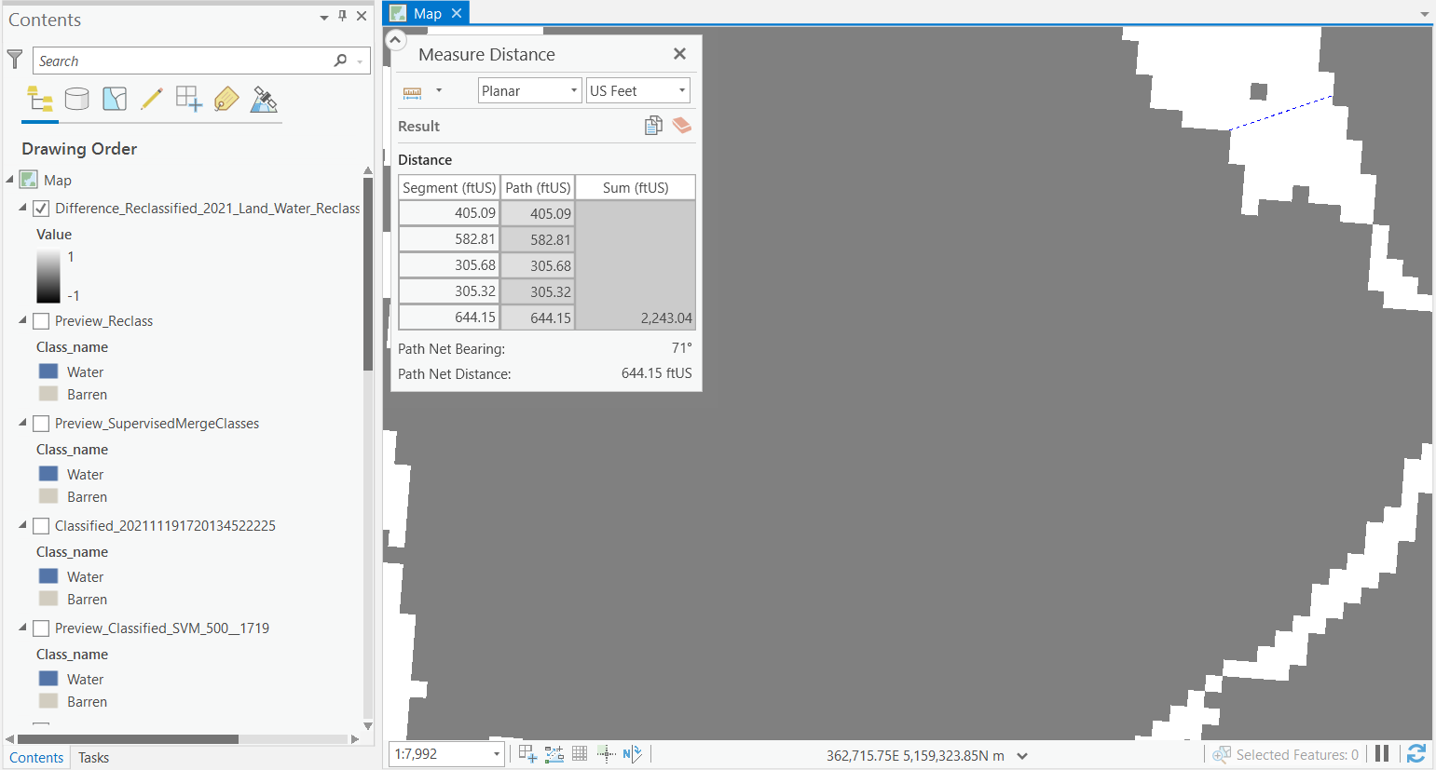
Difference Layer
Ave=448.61 ft

Slide 15
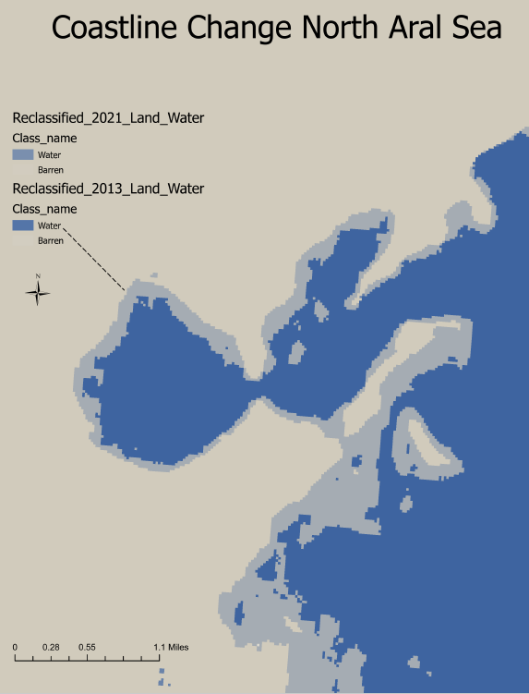
Summary
Level of change in coastline has decreased (unexpected) in region of interest
Elevation plays role is water level / coastline change
Dam may have reached maximum effectiveness
Evaporation > Dam effects
Compounded by climate change
Precipitation
Year by year study more meaningful for Dam effects
Data Availability & Resolution
Confirmed-Dam needs increase in height of at least 7’

Slide 16
Abstract
The story of the greatest man-made environmental disaster in know history is told by the Aral Sea (a large-inland lake). The 1950’s Soviet diversion of source rivers for purpose of cotton and wheat irrigation reduced the sea to 10% of it’s original size today (2021). The decision to sacrifice the southern portion of the Aral Sea to restore the northern portion was made in 2003. Kokaral Dam (built 2005) raised the sea level and started the rebuilding of local communities. An effort to approximate the change in surface area (coastline increase) was attempted with Raster Analysis, using ESRI’s ArcGIS Pro and accompanying satellite data from the USGS. Satellite images were gathered from earliest sources since the Dam’s inception and then compared to most recent available data. Data was converted to raster and pixel classified into “barren land” and “water”. Results show the coastline has unexpectedly decreased by ~ 445 ft between 2015 and 2021.

Slide 17
Sources
Restoring Life in the Aral Sea’s Dead Zone, BBC News, June 1, 2018
Rustam Qobil & Paul Harris, BBC Uzbekistan
https://www.bbc.com/news/business-44159122
“Performing Supervised Pixel-Based Image Classification”
Esri Academy, online course
https://www.esri.com/training/catalog/5c75869c65e21d6e2187b712/performing-supervised-pixel-based-image-classification/
Glovis Web App, USGS, Landsat Imagery Database
https://glovis.usgs.gov/app?fullscreen=0
Northern Aral's promise stunted by dam height, international disputes, Astana Times, Aliya Uteuova, Oct 2020
https://eurasianet.org/northern-arals-promise-stunted-by-dam-height-international-disputes
Dr. Jeff Tolhurst, Columbia College Department of Geosciences, Sonora CA 95370

Slide 18
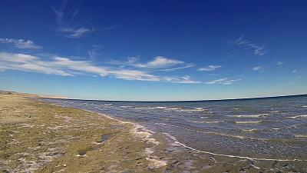
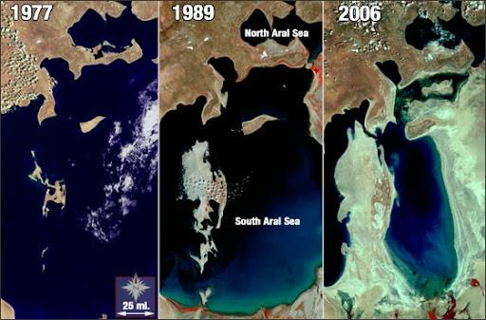
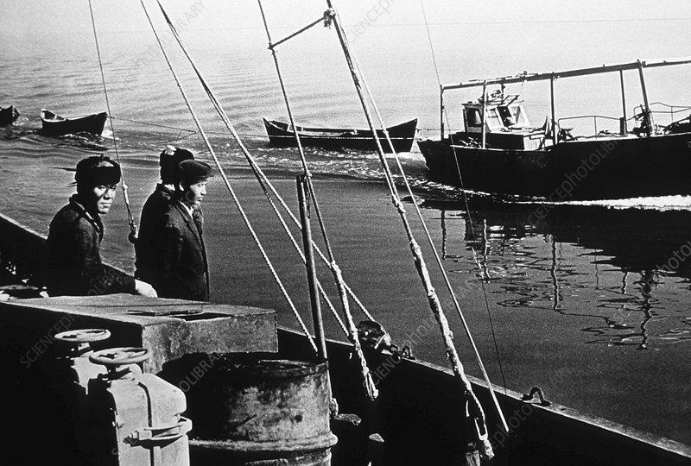
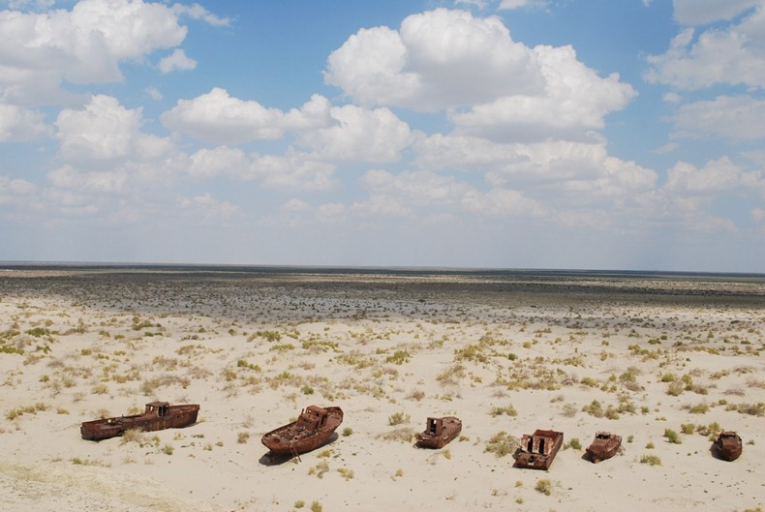
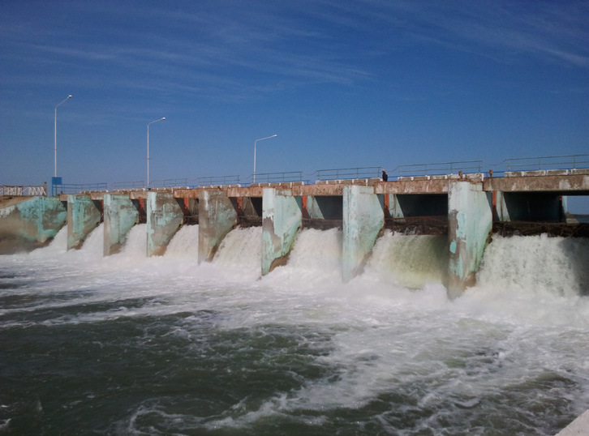
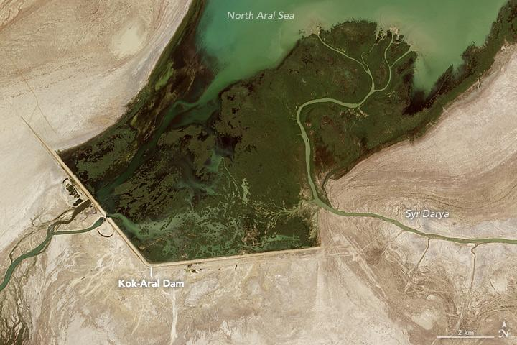
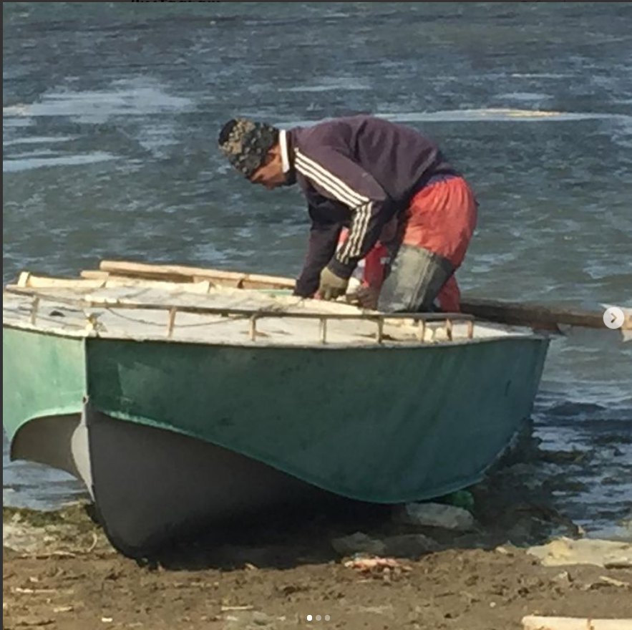
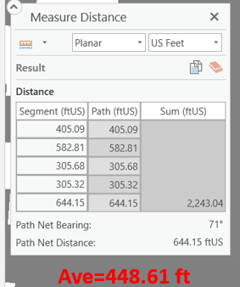
Using Raster Based GIS to Monitor
Recovery of Northern Aral Sea, Kazakhstan-T. Haniff, Columbia College
Poster:
Soviet Diversion of Feeding Rivers for Wheat and Cotton Irrigation-late 1950’s
Kokaral Dam,
World Bank Project 2005
Initial rise in water level and resurgence of fishing/community
Satellite Imagery🡪 Raster Analysis
Net decrease (~445 ft) in coastline near Zhalanash from 2015-2021
Dam reached maximum effect in this area

